Slide 1

Online Convex Optimization
智能出行部 生态策略组
高佳佳

Slide 2
Outline
Introduction
Examples
Sparsity
Extensions
FTRL
Definition
Methods
Mirror Descent

Slide 3
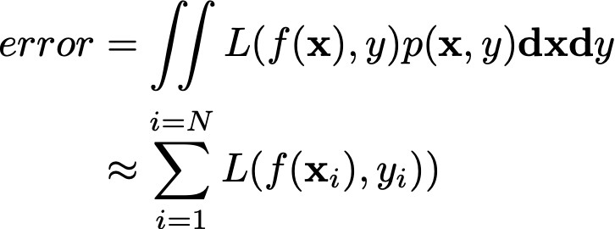
Introduction
Statistical learning (SL)
The learner receives samples and must select a generalization function (called the hypothesis) from a certain class of possible functions. The goal is that, with high probability (the "probably" part), the selected function will have low generalization error . The learner must be able to learn the concept given any arbitrary distribution of the samples.
i.i.d. from an
unknown distribution
Hypothesis space

Slide 4
Introduction
Examples of Statistical Learning:
XGBoost training on entire data set.
Deep Learning with batch training for several epochs.
……
Features
Labels
Cancel Judge
Training set, generally with a window size of 1 week or 1 month
Feedbacks
Drawbacks of statistical learning:
i.i.d. request (what if the data distribution changes? model update, retraining?).
Training on entire data set (What if there are no sufficient computational resources, single machine, memory…).

Slide 5
Introduction-Online Learning
Online learning is a common technique used in areas of machine learning where it is computationally infeasible to train over the entire dataset, requiring the need of out-of-core algorithms. It is also used in situations where it is necessary for the algorithm to dynamically adapt to new patterns in the data, or when the data itself is generated as a function of time.
model
t th display
user feedbacks, click or non-click
update model
choose an ad_t
Online Advertising

Slide 6
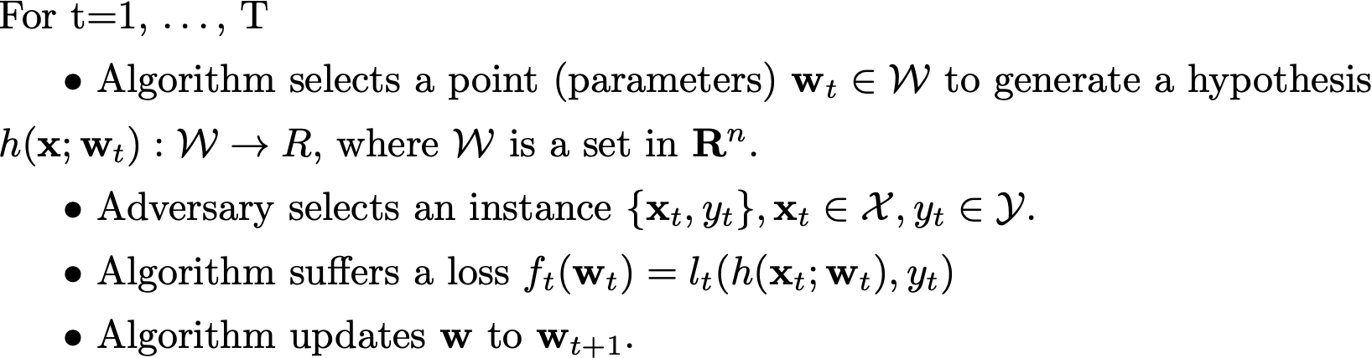
Online Learning
Current model
Ad display & user feedback (clicks or not)
Update model
Convex?

Slide 7
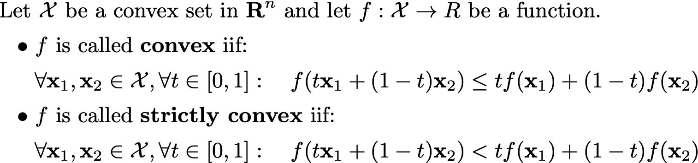
Preliminaries-convexity
Strictly convex
Convex

Slide 8
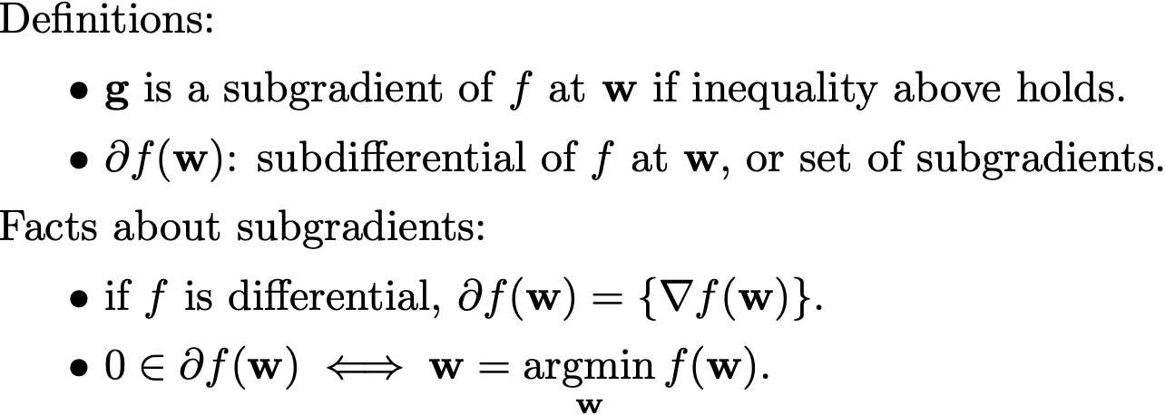
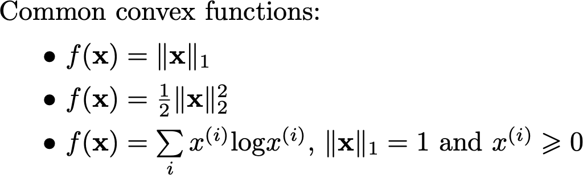
Preliminaries-convexity & sub-gradients
Equivalent definition of convex function
First order taylor expansion

Slide 9
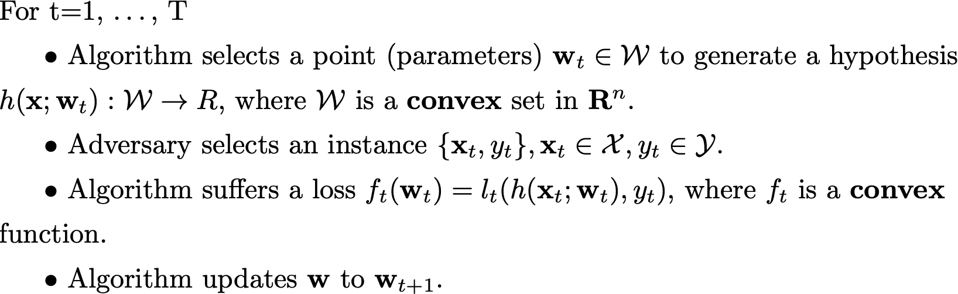
Online Convex Optimization

Slide 10
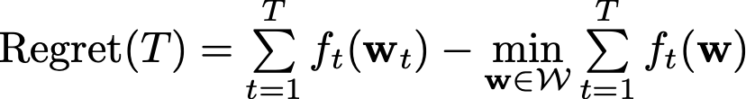
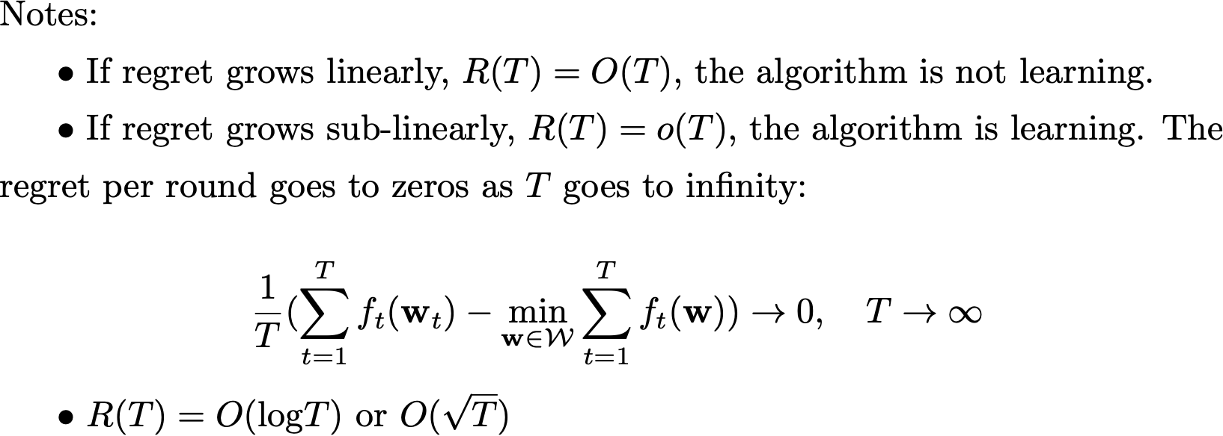
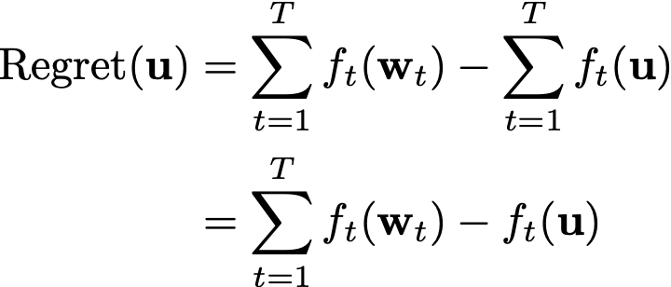
OCO-Regret
In statistical learning, we aim to minimize empirical loss.
In online learning, we care about the diﬀerence between the real cumulative loss and the minimum cumulative loss, called regret.

Slide 11
Comparisons

Slide 12
Outline
Introduction
Examples
Sparsity
Extensions
FTRL
Definition
Methods
Mirror Descent

Slide 13
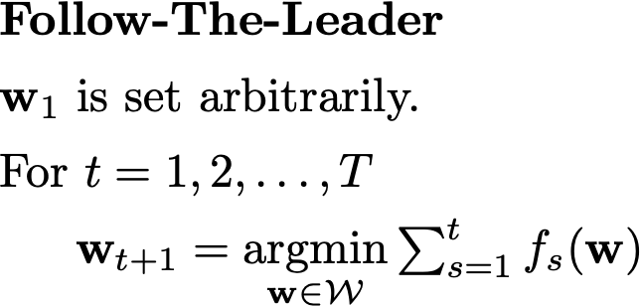
FTL
Notes:
Similar to batch learning (minimize regret using entire data at round t)
Computation gets slower as t increases. Impractical for most situations.

Slide 14
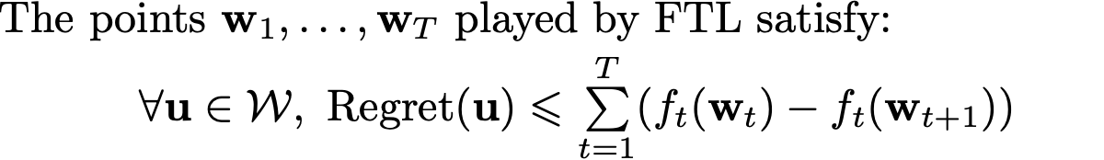
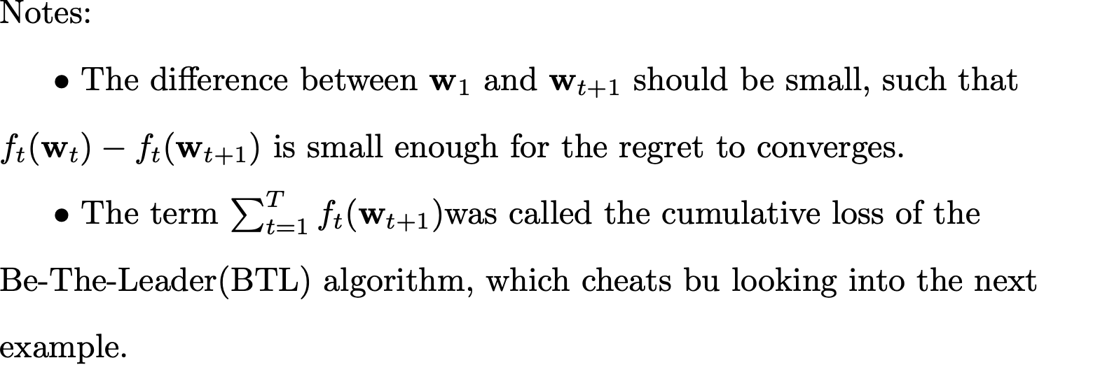
FTL
Bound

Slide 15
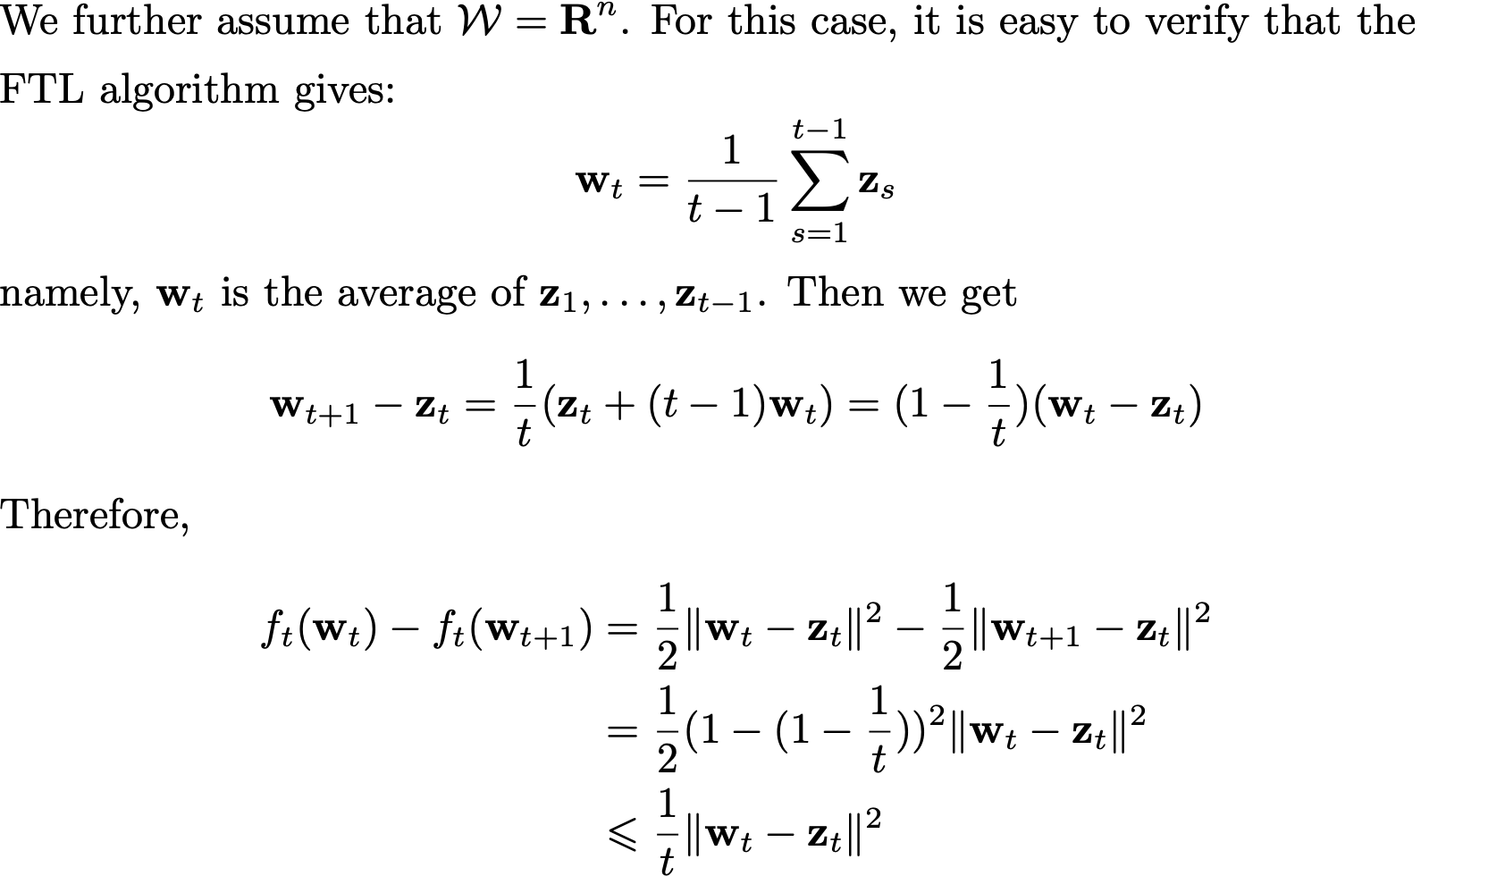
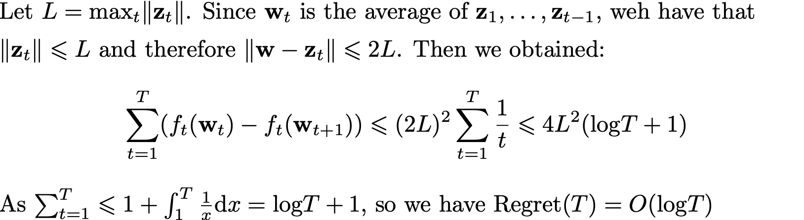
FTL
Example that FTL works.

Slide 16
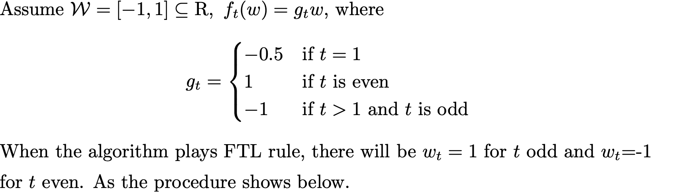
FTL
Example that FTL fails. (A case of Online Linear Optimization)
Linearly grows, bad convergence

Slide 17
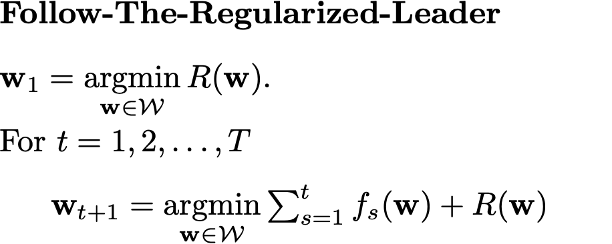
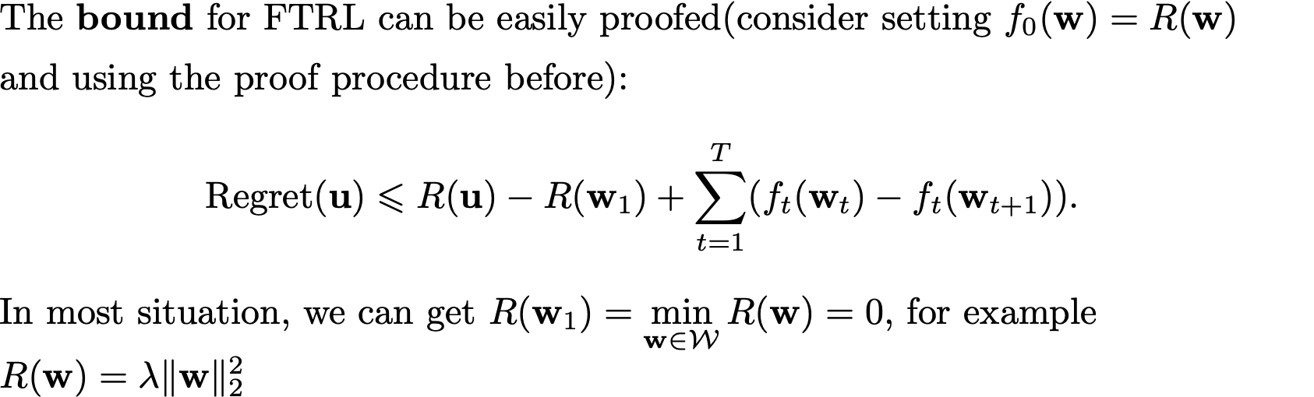
FTRL
Stabilize the algorithm by adding a regularizer

Slide 18
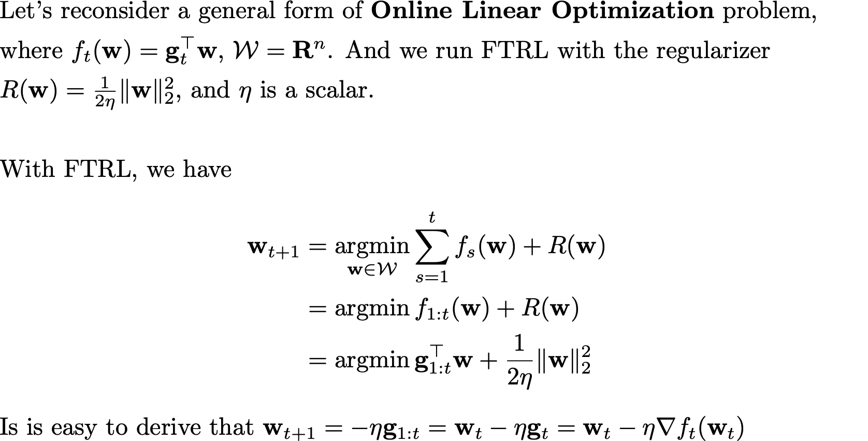
FTRL
Online Gradient Descent

Slide 19
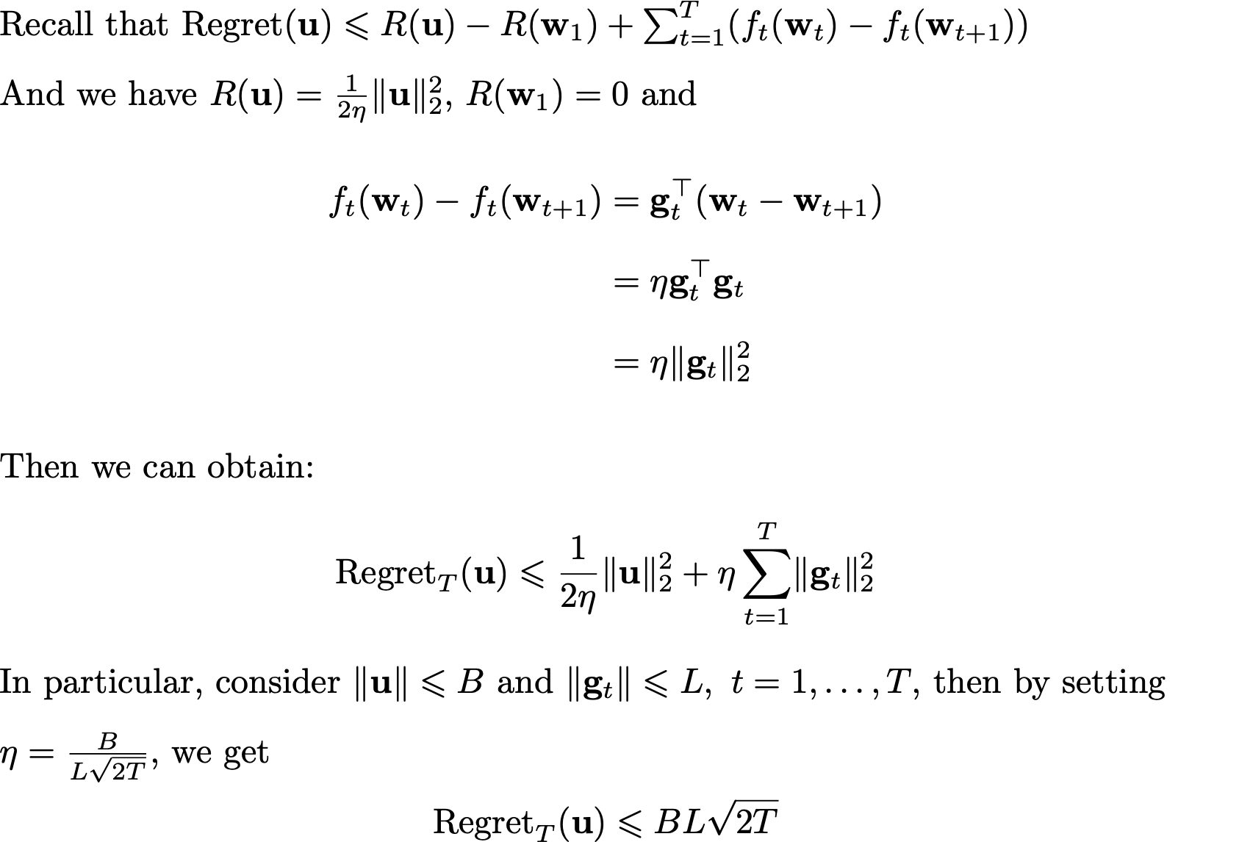
FTRL
Bound for FTRL with Online Linear Optimization problem

Slide 20
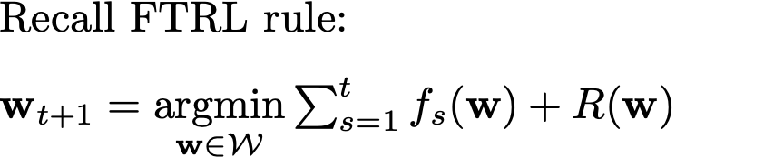
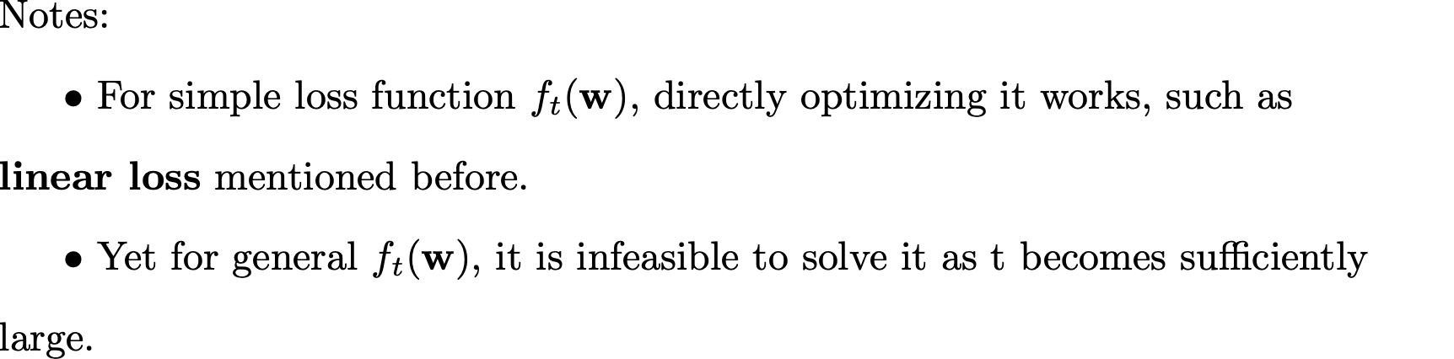
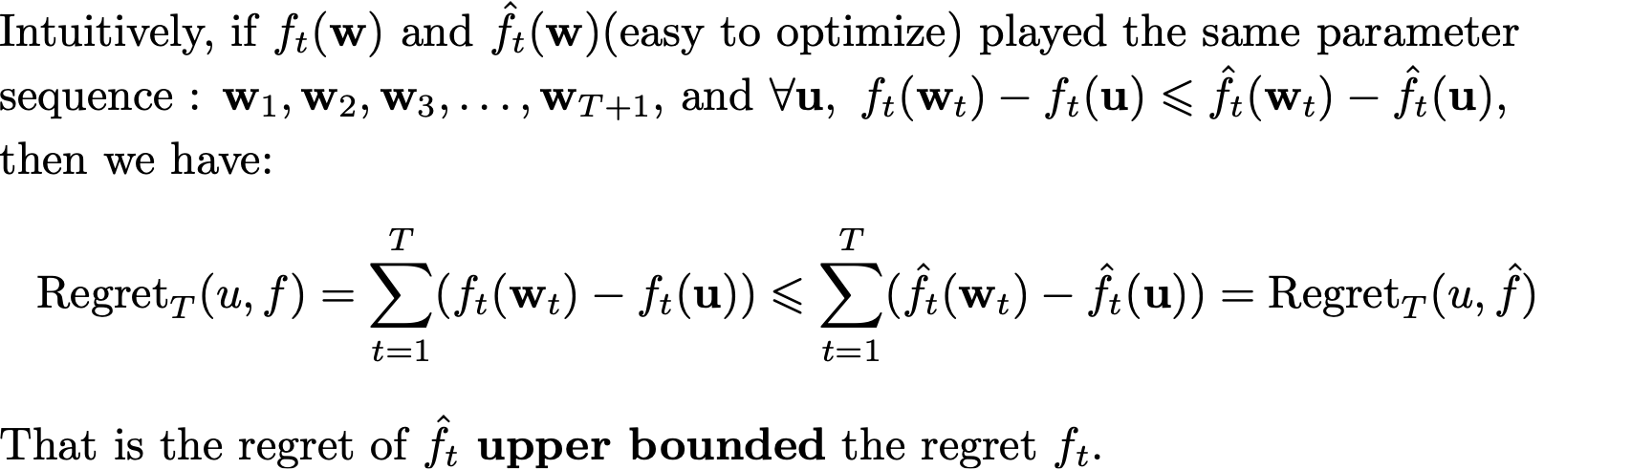
Linearization
How to construct ?

Slide 21
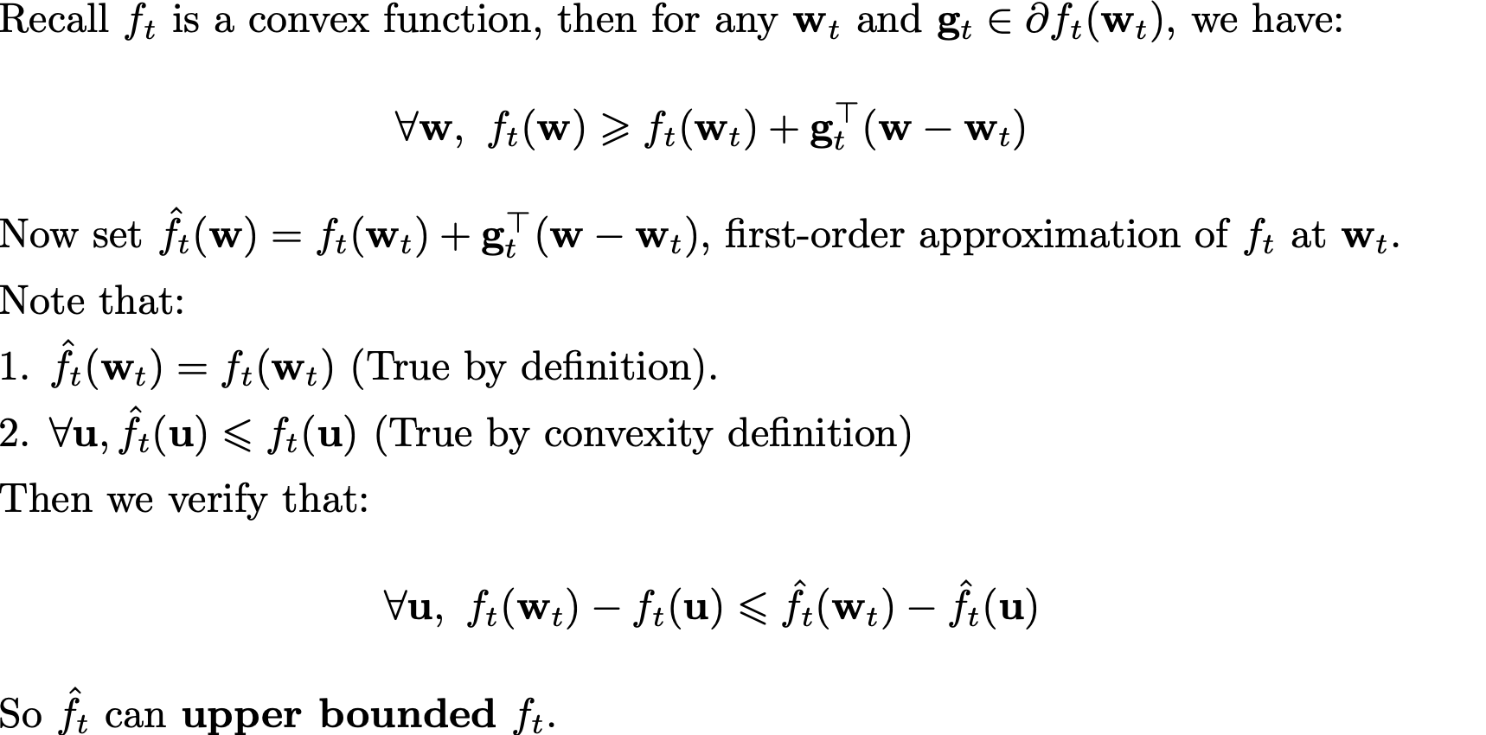
Linearization
Using convexity to transform f_t
Note that this transform is algorithm-free.

Slide 22
Linearization

Slide 23
General Diagram

Slide 24
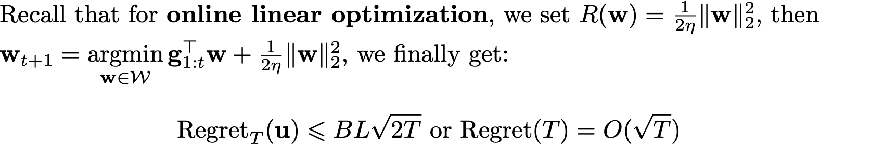
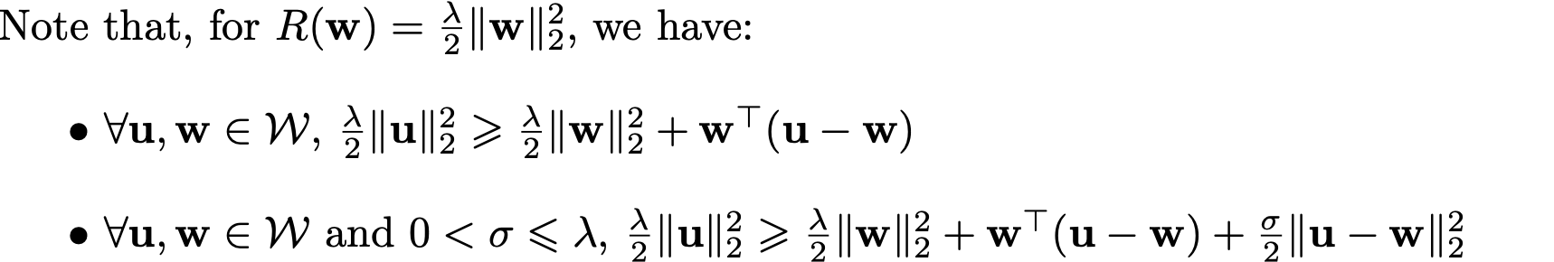
FTRL-strong convexity
A regularizer with good properties can ensure convergence.
Convexity
Strongly convexity

Slide 25
Preliminaries
Norm
Examples
Dual norm

Slide 26
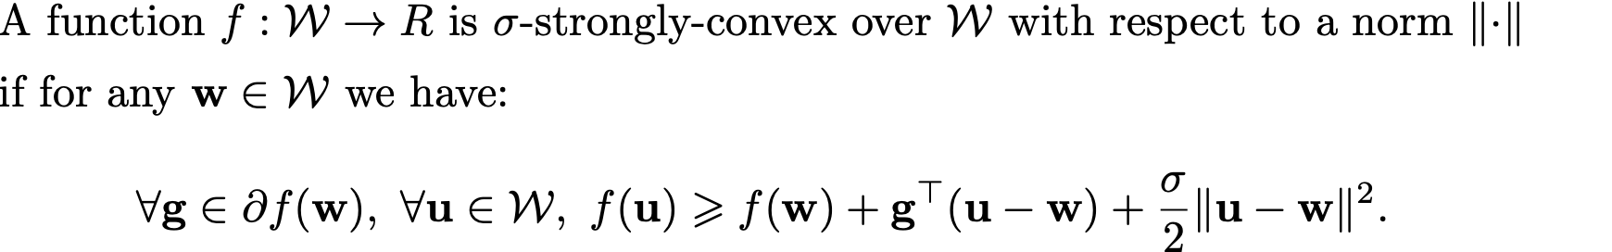
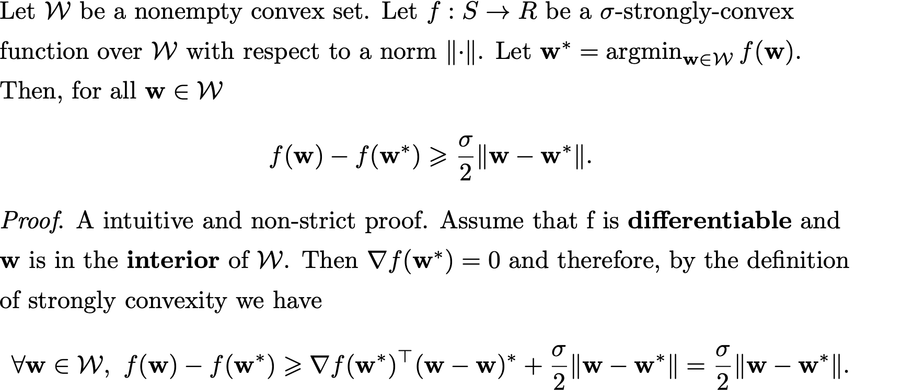
Preliminaries
Strongly Convexity

Slide 27
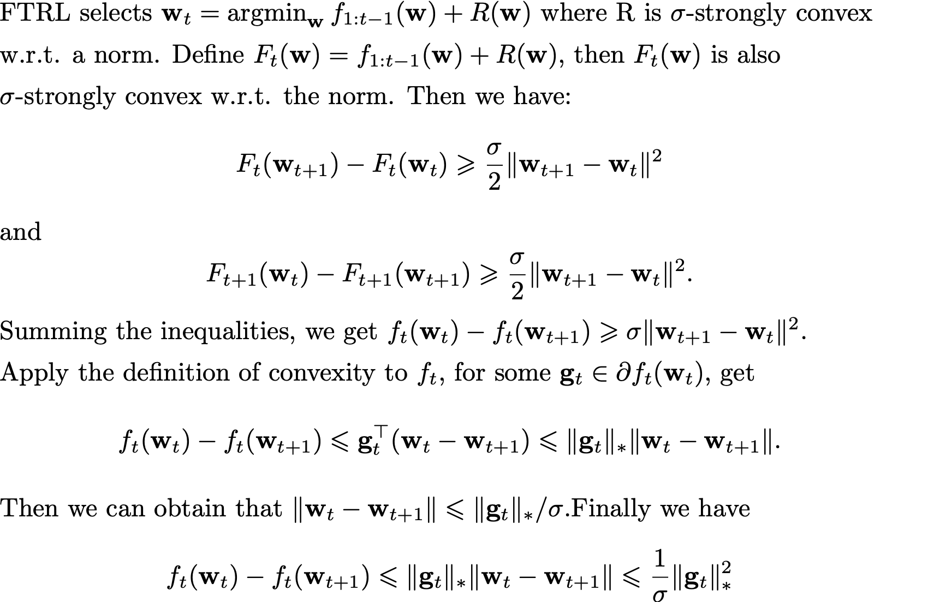
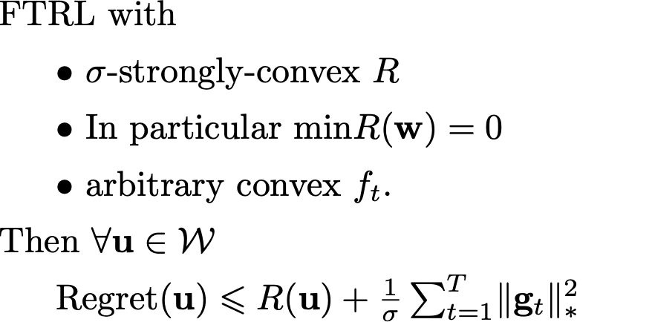
FTRL bound with strongly convex regularizer

Slide 28

Adaptive-FTRL
R(w) stays the same for each round.
An adaptive FTRL algorithm

Slide 29
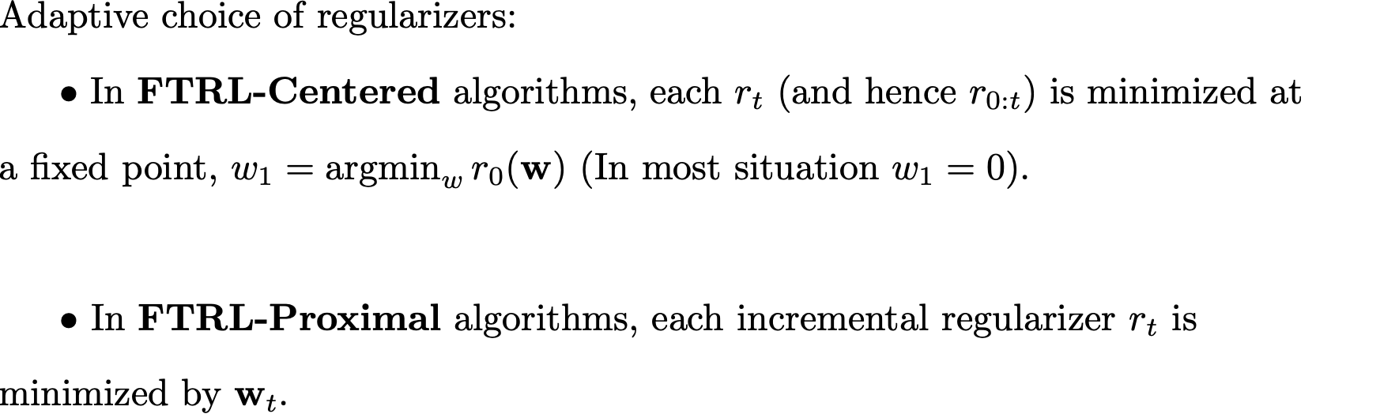
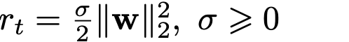
Adaptive-FTRL
Centered and Proximal cases cover the most situations for practical usages.

Slide 30
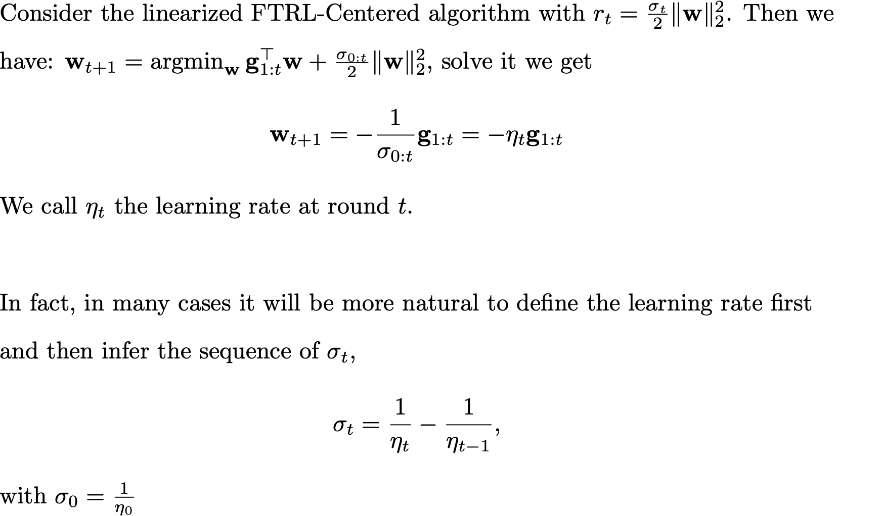
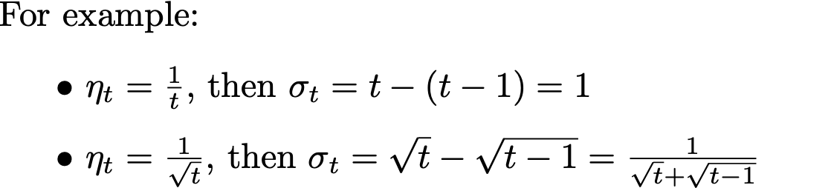
Adaptive-FTRL
Learning rate and regularizers.
Adaptive

Slide 31
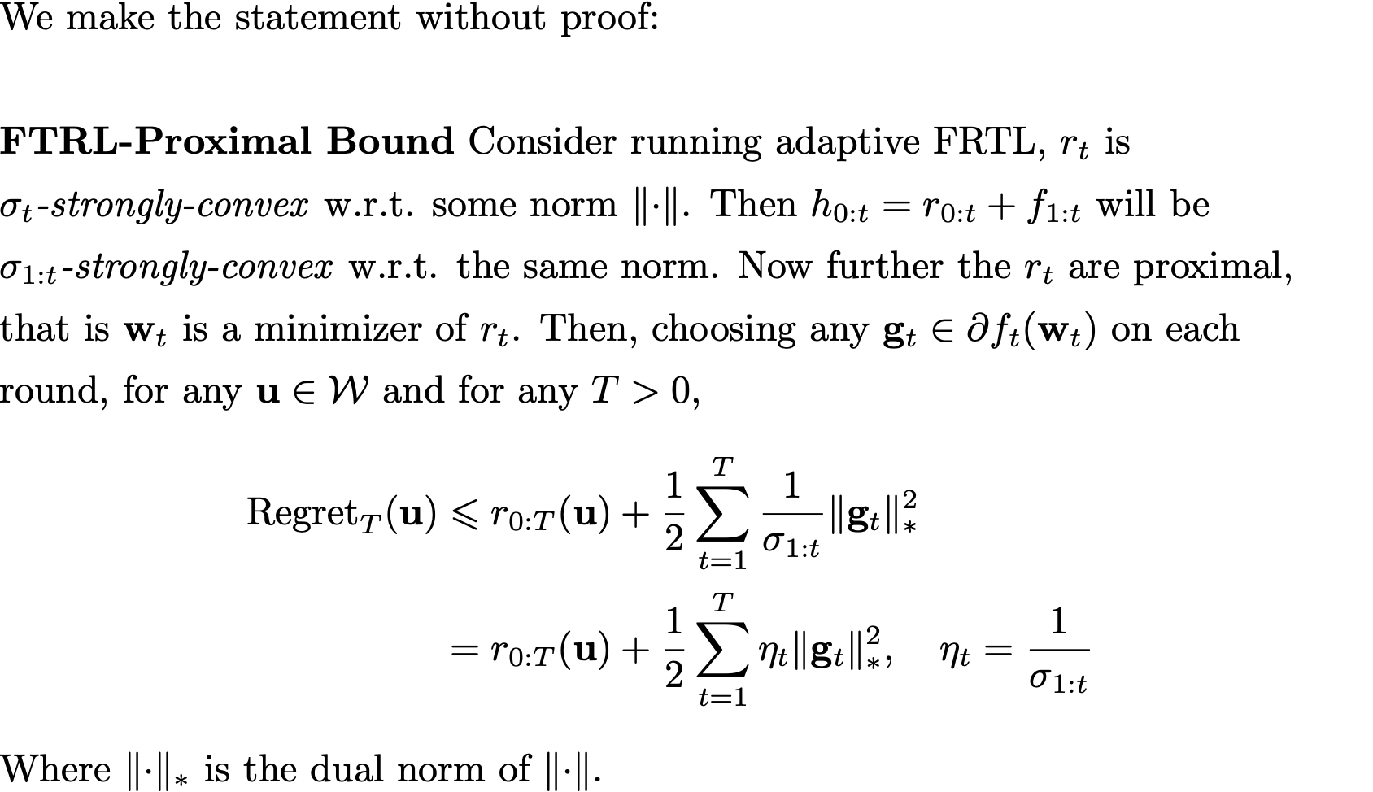
Adaptive-FTRL: Bound

Slide 32
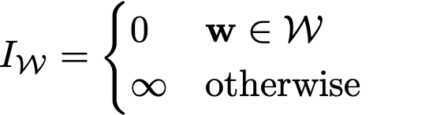
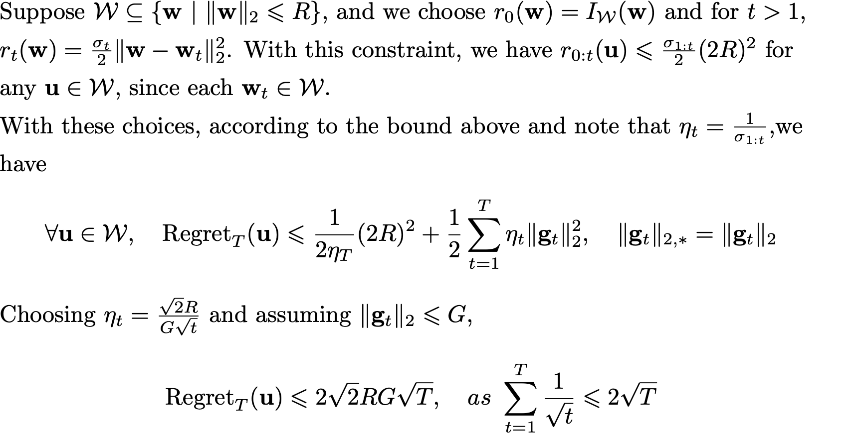
Adaptive-FTRL: Bound
FTRL-Proximal with l2 regularizer.
Notes:
The learning rates are adaptively chosen without knowing T in advance.
But we still need to know the bound on the norms of gradients G.

Slide 33
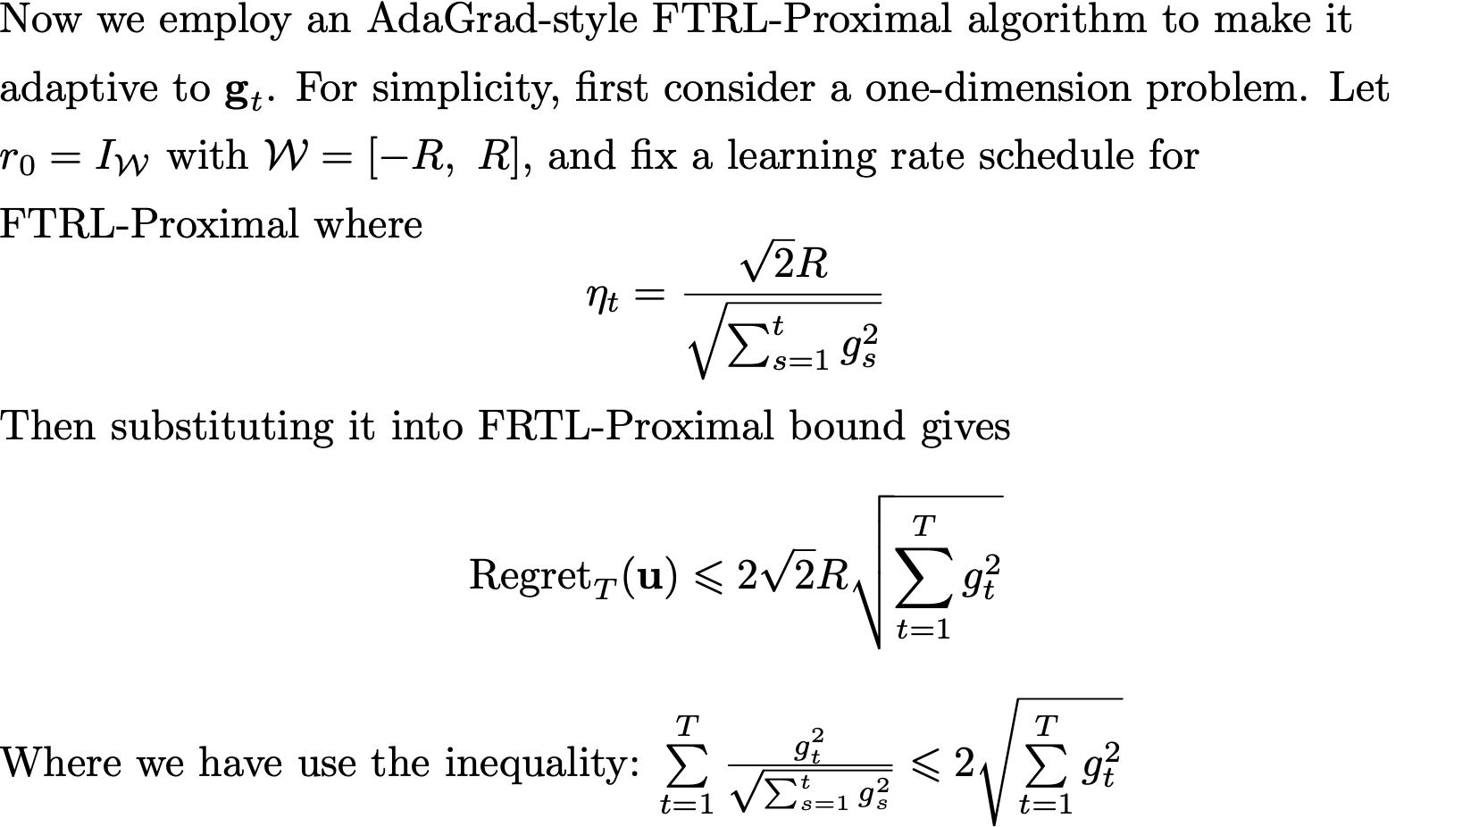
Adaptive-FTRL: Bound
Notes:
This Eq. gives a fully adaptive version of FTRL-Proximal.
We do not need to know T in advance or the bound on the norm of gradients.
Yet R is still required to be chosen in advance.

Slide 34
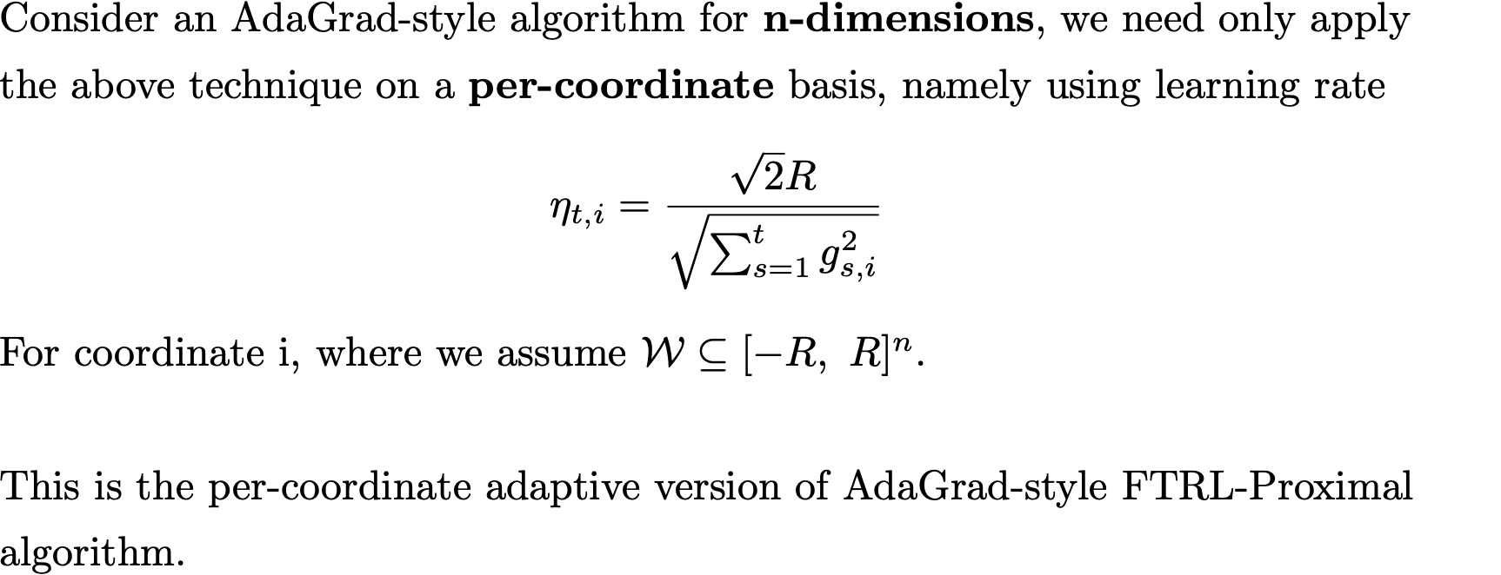
Adaptive-FTRL: Bound

Slide 35
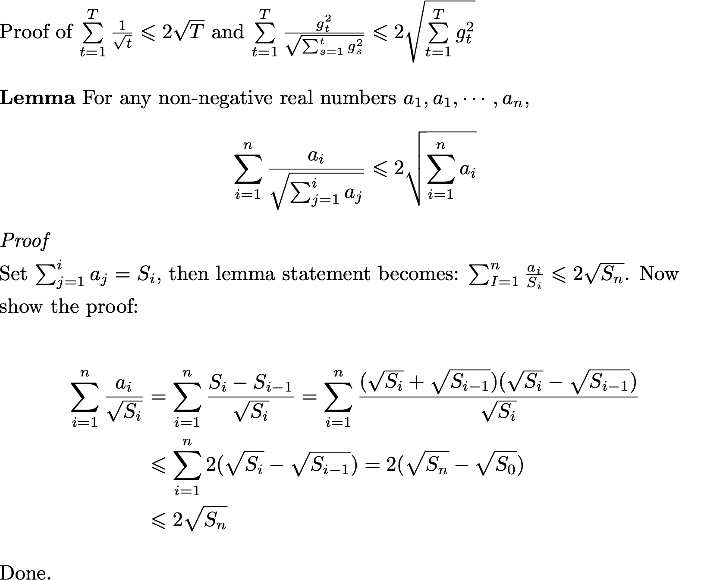
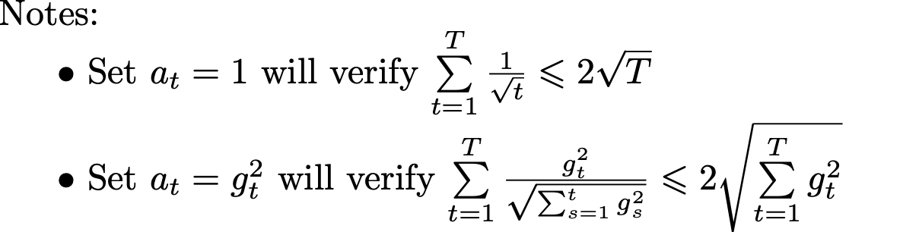
Adaptive-FTRL: Bound

Slide 36
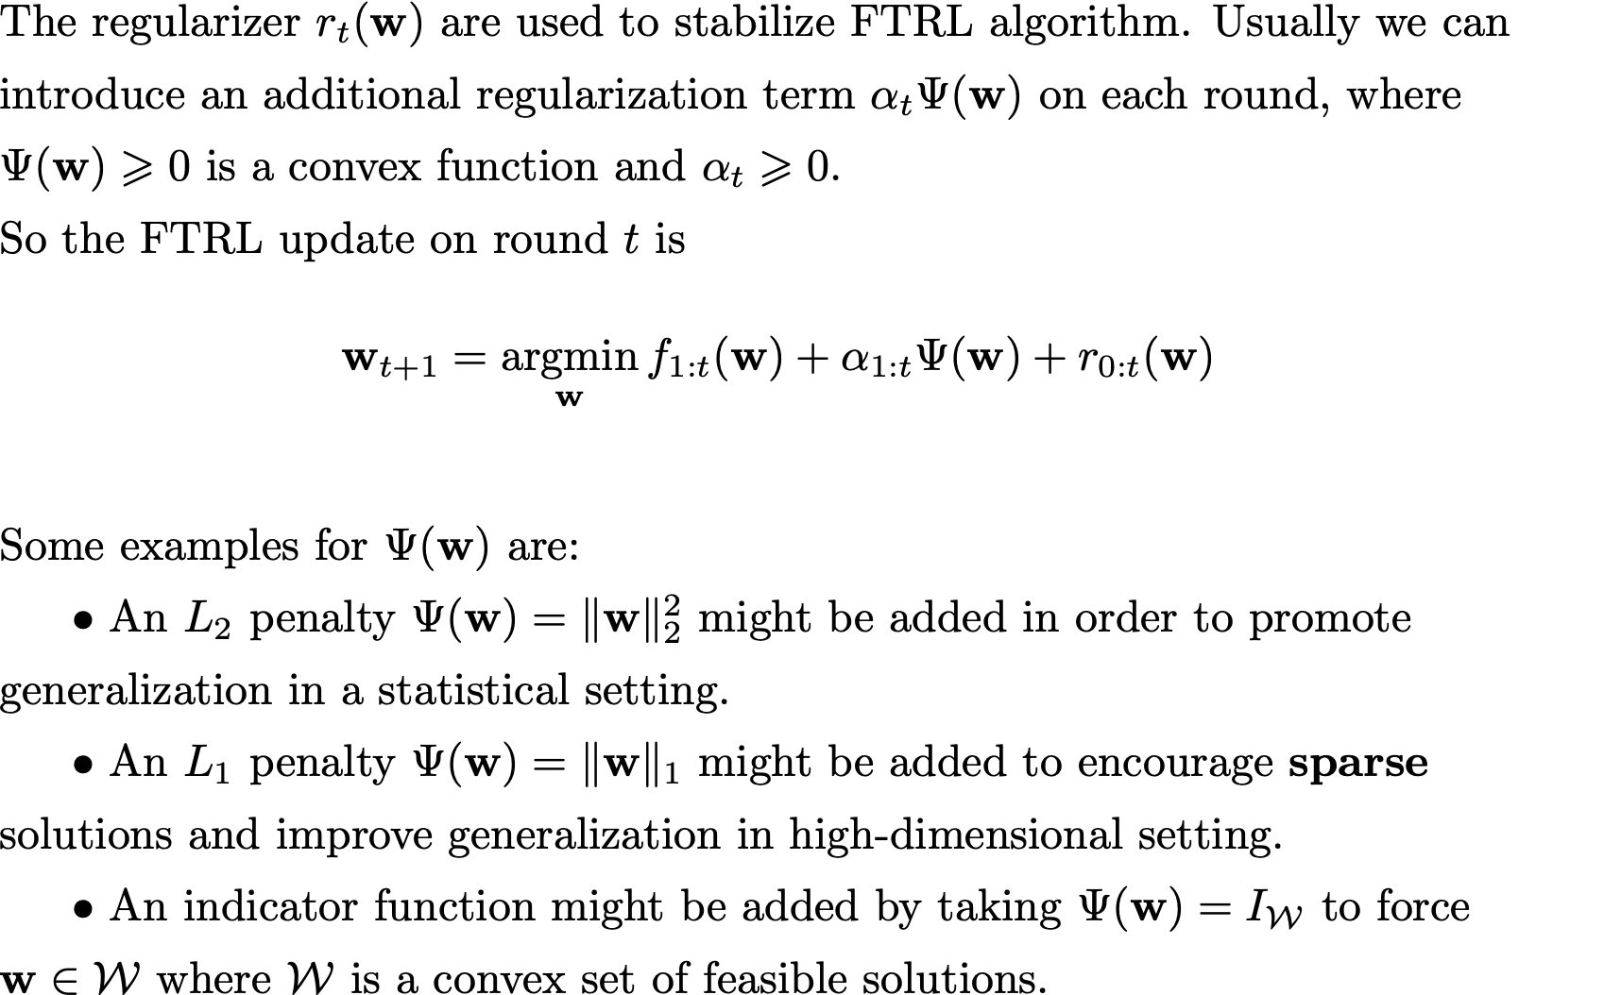
Adaptive-FTRL: Additional Reg.

Slide 37
Outline
Introduction
Examples
Sparsity
Extensions
FTRL
Definition
Methods
Mirror Descent

Slide 38
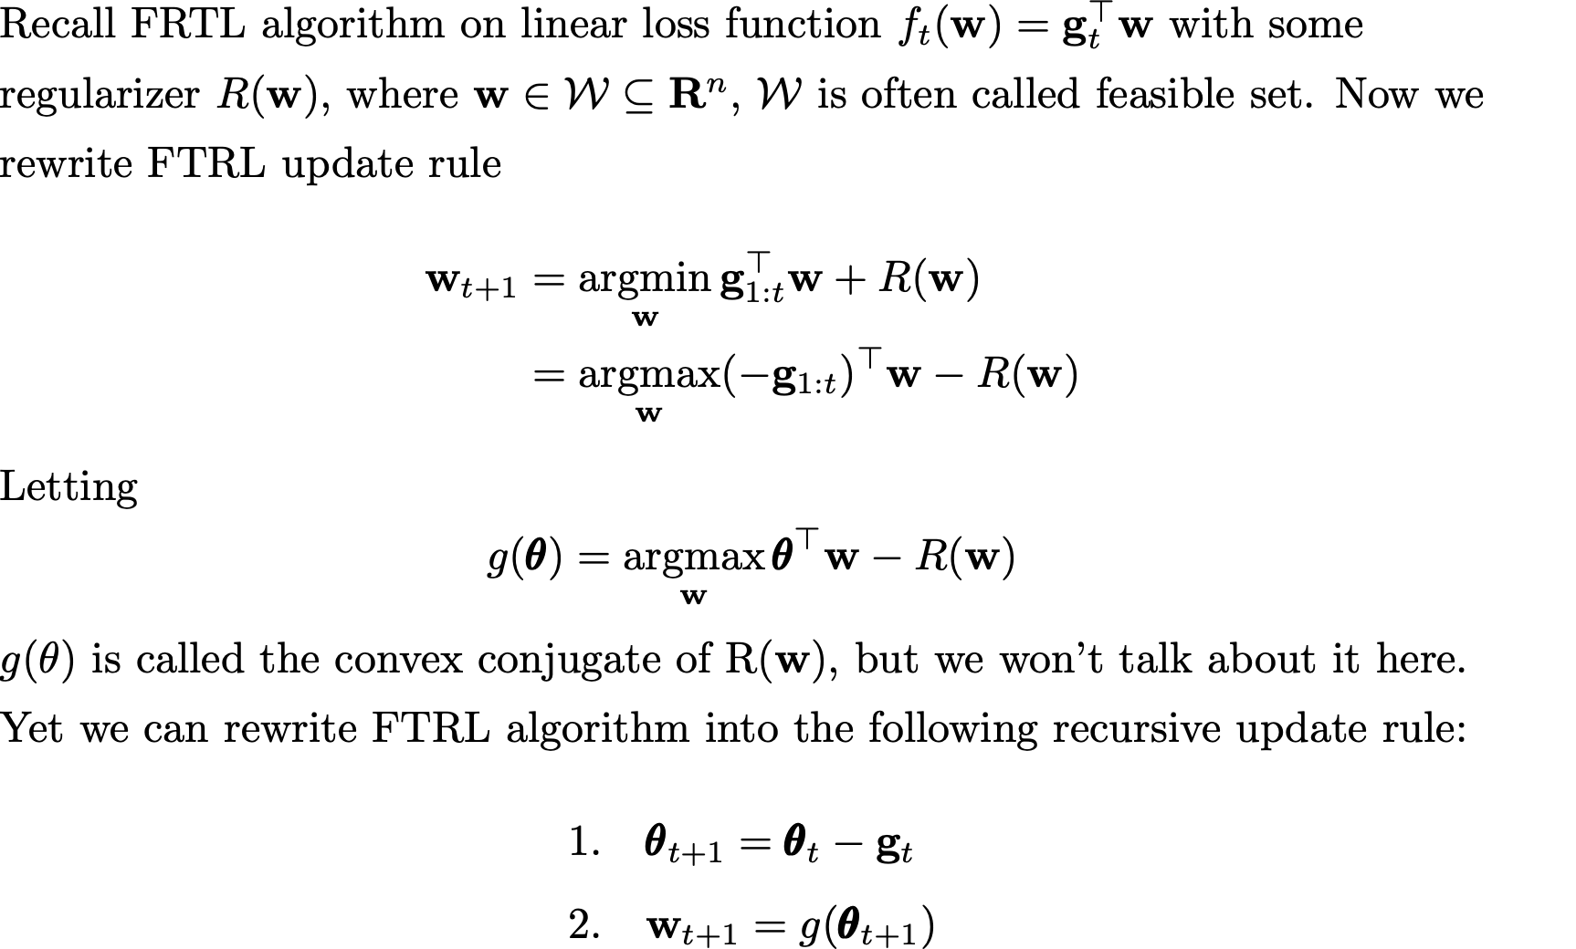
Online Mirror Descent
Note:
if f_t is convex but nonlinear, we can use sub-gradients to linearize the problem.

Slide 39
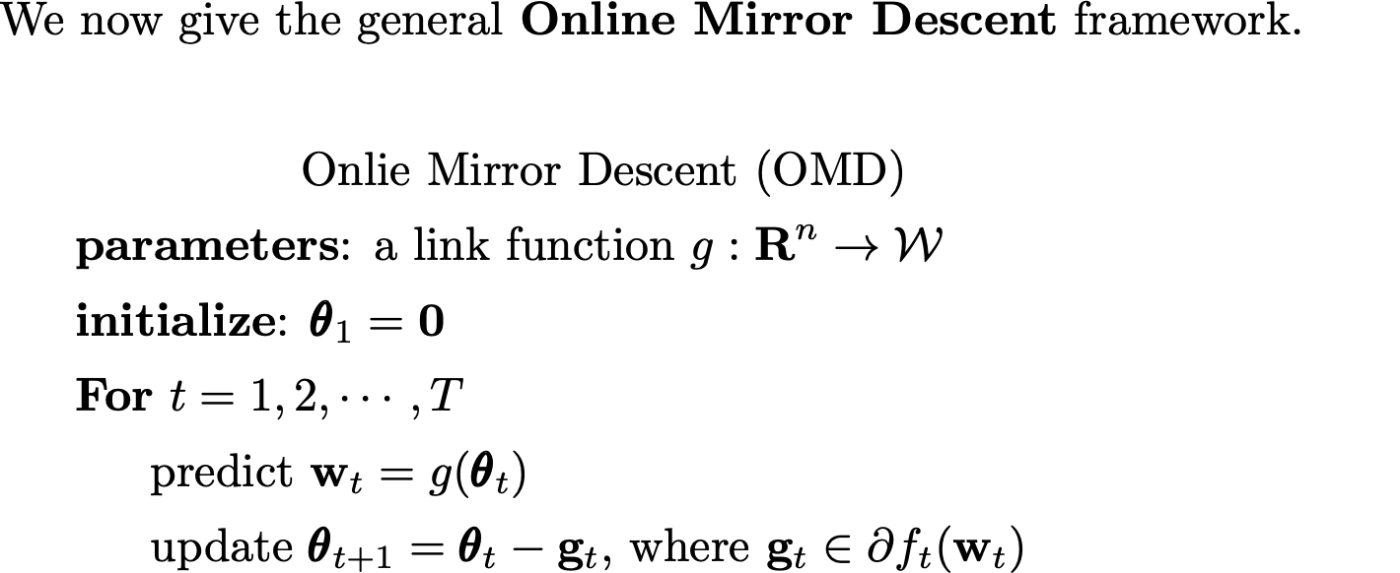
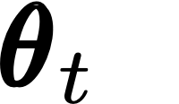


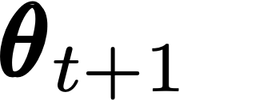
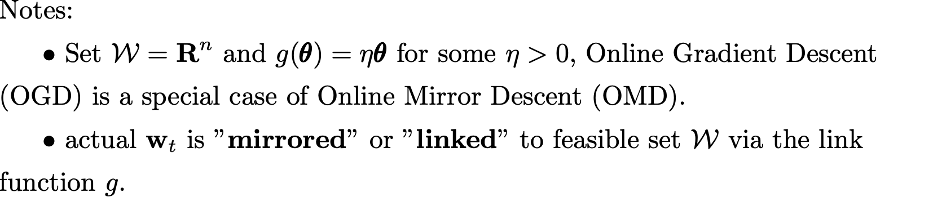
Online Mirror Descent
Projection

Slide 40
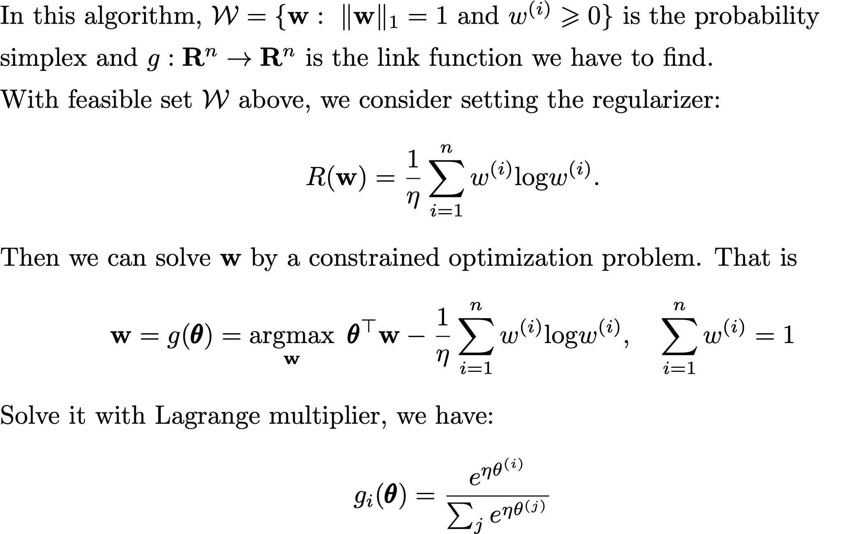
Online Mirror Descent
Example: Normalized Exponentiated Gradients.

Slide 41
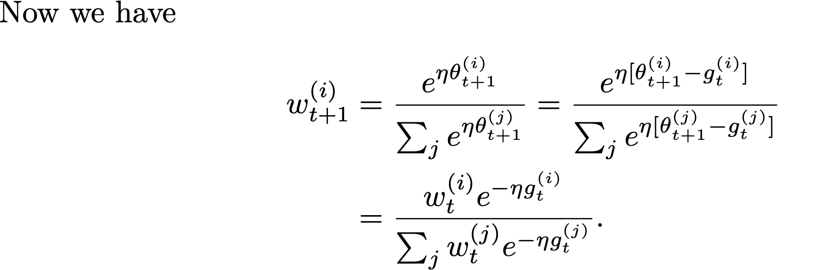
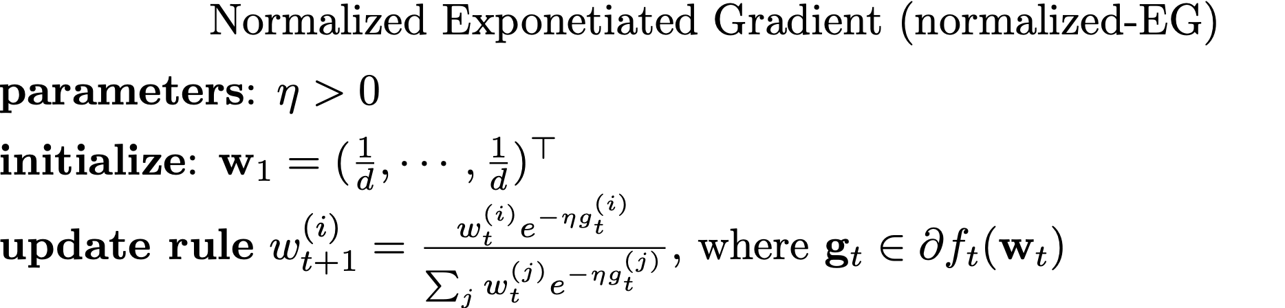
Online Mirror Descent
Example: Normalized Exponentiated Gradients.

Slide 42
Online Mirror Descent
Notes:
Compare to FTRL, OMD don’t need to solve an optimization problem at each round.
Projection method is more intuitive to combine a feasible set to online learning problem.
In a more general framework, it is proved that Online Mirror Descent is a special case of FTRL-Proximal algorithm.

Slide 43
Outline
Introduction
Examples
Sparsity
Extensions
FTRL
Definition
Methods
Mirror Descent

Slide 44
Sparsity
Advantages of sparsity
Feature selection, get the main structure of the problem.
Reduce the complexity of inference.
(Online) Gradient Descent with L1-Regularization
不同于 Batch，Online 中每次𝑊的更新并不是沿着全局梯度进行下降，而是沿着某个样本的产生的梯度方向进行下降，整个寻优过程变得像是一个“随机” 查找的过程（SGD 中 Stochastic 的来历），这样 Online 最优化求解即使采用 L1 正则化的方式， 也很难产生稀疏解
Regularization of Batching Training.

Slide 45
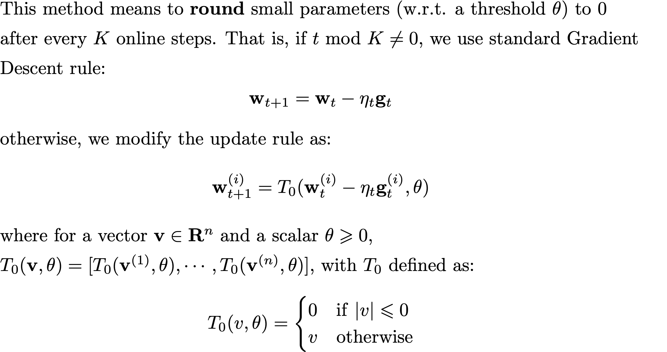
Sparsity: SCR
简单截断法 (Simple Coefﬁcient Rounding)
Aggressive
Simple Coefﬁcient Rounding

Slide 46


Sparsity: TG
截断梯度法 (Truncated Gradient)
Truncated Gradient

Slide 47
Sparsity: TG vs SCR
Simple Coefﬁcient Rounding
Truncated Gradient

Slide 48

Sparsity: FOBOS
FOBOS (Forward-Backward Splitting)
Sub-gradient descent
Projection
Forward-Looking Subgradient

Slide 49


Sparsity: L1-FOBOS
每个维度分别求解
带绝对值的二次规划
Notes:
FOBOS针对单个样本的梯度进行判定，若某些维度训练不足，则会导致不合理的权重截断
$η_{t+\frac{1}{2}}$通常会定义为$\frac{1}{\sqrt{t}}$正相关的函数，因此随着t增加，截断阈值会逐渐减小，稀疏效应减弱

Slide 50

Sparsity: L1-FOBOS

Slide 51




Sparsity: L1-FOBOS vs TG
L1-FOBOS
TG

Slide 52

Sparsity: RDA
RDA (Regularized Dual Averaging)

Slide 53

Sparsity: L1-RDA

Slide 54

Sparsity: L1-RDA

Slide 55


Sparsity: L1-RDA vs L1-FOBOS
L1-FOBOS
L1-RDA
Notes:
FOBOS针对单个样本的梯度进行判定，若某些维度训练不足，则会导致不合理的权重截断, 而RDA对梯度的累积均值进行判定，避免了这个问题
$η_{t+\frac{1}{2}}$通常会定义为$\frac{1}{\sqrt{t}}$正相关的函数，因此随着t增加，截断阈值会逐渐减小，稀疏效应减弱
RDA的阈值是常数，不随时间t变小，因此相比FOBOS，稀疏效应更加aggressive. 更容易产生稀疏解。

Slide 56

Sparsity: FTRL-Proximal
FTRL-Proximal

Slide 57

Sparsity: FTRL-Proximal
Considering both history of g_t and w_t

Slide 58

Sparsity: FTRL-Proximal
A Logistic Regression Model
Per-coordinate

Slide 59
Sparsity: Examples
AUC on different small datasets
In practice, try both
RDA and FTRL !
Sparsity VS AUC on real-world tasks

Slide 60
Outline
Introduction
Examples
Sparsity
Extensions
FTRL
Definition
Methods
Mirror Descent

Slide 61





General Equivalence
FOBOS
RDA
FTRL-Proximal

Slide 62

General Equivalence

Slide 63
References
https://en.wikipedia.org/wiki/Probably_approximately_correct_learning
https://en.wikipedia.org/wiki/Online_machine_learning#Online_subgradient_descent_(OSD)
Langford etc._2009_Sparse Online Learning via Truncated Gradient (TG)
Duchi&Singer_2009_Efﬁcient Online and Batch Learning Using Forward Backward Splitting (FOBOS)
Xiao_2010_Dual Averaging Methods for Regularized Stochastic Learning and Online Optimization (RDA)
McMahan_2011_Follow-the-Regularized-Leader and Mirror Descent: Equivalence Theorems and L1 Regularization (compare FOBOS、RDA and Online Mirror Descent)
Shalev-Shwartz_2011_Online Learning and Online Convex Optimization (survey)
McMahan etc._2013_Ad Click Prediction: a View from the Trenches (real-world application)
McMahan_2017_A Survey of Algorithms and Analysis for Adaptive Online Learning (adaptive-ftrl survey)
冯扬_2014_在线最优化求解(Online Optimization) (sparsity)
McMahan_2014_online learning course (https://courses.cs.washington.edu/courses/cse599s/14sp/index.html) (course)

Slide 64
Thank You

